Slide 1
Merge Sort
Merge sort:
  divide a list into two halves
  sort the halves
  recombine the sorted halves into a sorted whole
Merge sort is an example of a “divide and conquer” algorithm
divide and conquer algorithm: an algorithm that repeatedly divides the given problem into smaller pieces that can be solved more easily
  it’s easier to sort the two small lists than the one big list

Slide 2
Merge Sort Picture
0 | 1 | 2 | 3 | 4 | 5 | 6 | 7
22 | 18 | 12 | -4 | 58 | 7 | 31 | 42
split
22 | 18 | 12 | -4
58 | 7 | 31 | 42
22 | 18
12 | -4
58 | 7
31 | 42
22
18
12
-4
58
7
31
42
18 | 22
-4 | 12
7 | 58
31 | 42
merge
-4 | 12 | 18 | 22
7 | 31 | 42 | 58
0 | 1 | 2 | 3 | 4 | 5 | 6 | 7
-4 | 7 | 12 | 18 | 22 | 31 | 42 | 58

Slide 3
Complexity of Merge Sort
To determine the time complexity, let’s break our merge sort into pieces and analyze the pieces
Remember, merge sort consists of:
  divide a list into two halves
  sort the halves
  recombine the sorted halves into a sorted whole
Dividing the list in half and recombining the lists are pretty easy to analyze:
  both have O(n) time complexity
But what about sorting the halves?

Slide 4
Complexity of Merge Sort
We can think of merge sort as occurring in levels
  at the first level, we want to sort the whole list
  at the second level, we want to sort the two half lists
  at the third level, we want to sort the four quarter lists
  ...
We know there’s O(n) work at each level from dividing/recombining the lists
But how many levels are there?
  if we can figure this out, our time complexity is just O(n * num_levels)

Slide 5
Complexity of Merge Sort
Because we divide the array in half each time, there are log(n) levels
So merge sort is an O(n log(n)) algorithm
  this is a big improvement over the O(n²) sorting algorithms
log(n) levels
O(n) work at each level

Slide 6
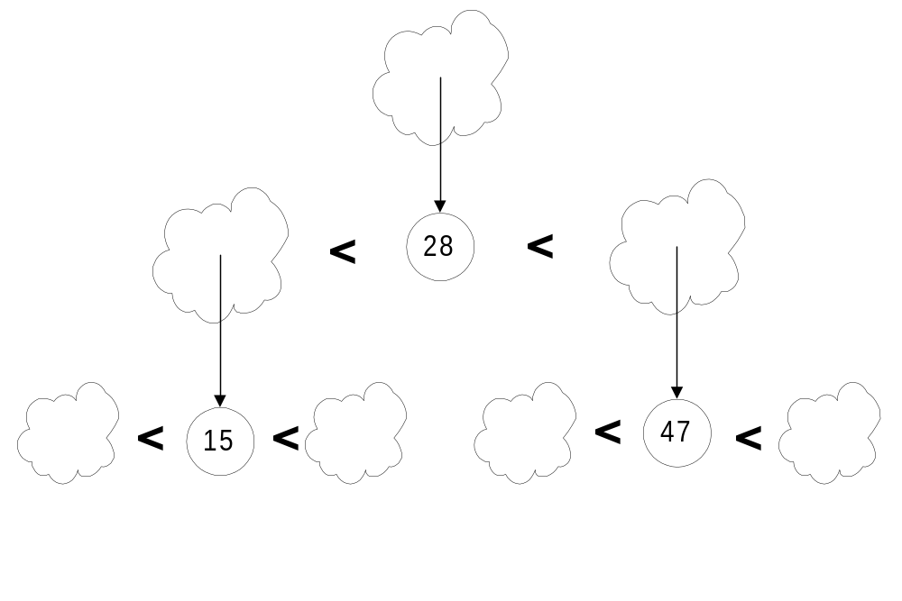
Quick Sort
Pick a “pivot”
Divide into less-than & greater-than pivot
Sort each side recursively

Slide 7
The steps of QuickSort
S
select pivot value
81
43
31
57
13
75
92
0
65
26
S₁
S₂
partition S
0
31
75
13
43
65
92
81
26
57
S₁
S₂
QuickSort(S₁) and
QuickSort(S₂)
0
13
26
31
43
57
65
75
81
92
S
0
13
26
31
43
57
65
75
81
92
Presto! S is sorted
[Weiss]

Slide 8
Quick sort vs. Merge sort
Quick sort:
  pick a pivot value from the array
  partition the list around the pivot value
  sort the left half
  sort the right half
Merge sort:
  divide a list into two identically sized halves
  sort the left half
  sort the right half
  recombine the sorted halves into a sorted whole

Slide 9
QuickSort Example
i
j
5
1
3
9
7
0
4
2
6
8
i
j
5
1
3
9
7
0
4
2
6
8
i
j
5
1
3
9
7
0
4
2
6
8
i
j
5
1
3
2
7
0
4
9
6
8
Move i to the right to be larger than pivot.
Move j to the left to be smaller than pivot.
Swap

Slide 10
QuickSort Example
i
j
5
1
3
2
7
0
4
9
6
8
i
j
5
1
3
2
7
0
4
9
6
8
i
j
5
1
3
2
4
0
7
9
6
8
i
j
5
1
3
2
4
0
7
9
6
8
j
i
5
1
3
2
4
0
7
9
6
8
j
i
0
1
4
2
4
5
6
9
7
8
S₁ < pivot
pivot
S₂ > pivot

Slide 11
Complexity Classes
Complexity Class | Name | Example
O(1) | constant time | popping a value off a stack
O(log n) | logarithmic time | binary search on an array
O(n) | linear time | scanning all elements of an array
O(n log n) | log-linear time | binary search on a linked list and good sorting algorithms
O(n²) | quadratic time | poor sorting algorithms (like inserting n items into SortedIntList)
O(n³) | cubic time
O(2^{n}) | exponential time | Really hard problems. These grow so fast that they’re impractical

Slide 12
Examples of Each Complexity Class’s Growth Rate
From Reges/Stepp, page 708:
  assume that all complexity classes can process an input of size 100 in 100ms
Input Size (n) | O(1) | O(log n) | O(n) | O(n log n) | O(n²) | O(n³) | O(2n)
100 | 100ms | 100ms | 100ms | 100ms | 100ms | 100ms | 100ms
200 | 100ms | 115ms | 200ms | 240ms | 400ms | 800ms | 32.7 sec
400 | 100ms | 130ms | 400ms | 550ms | 1.6 sec | 6.4 sec | 12.4 days
800 | 100ms | 145ms | 800ms | 1.2 sec | 6.4 sec | 51.2 sec | 36.5 million years
1600 | 100ms | 160ms | 1.6 sec | 2.7 sec | 25.6 sec | 6 min 49.6 sec | 4.21 * 10²⁴ years
3200 | 100ms | 175ms | 3.2 sec | 6 sec | 1 min 42.4 sec | 54 min 36 sec | 5.6 * 10⁶¹ years

